Slide 1
天文学科
听力练习3

Slide 2
Evidence shows that the Earth's is not . It wanders around and sometimes even ventures far away.

Slide 3
Evidence shows that the Earth's magnetic field is not stationary. It wanders around and sometimes even ventures far away.

Slide 4
It was , that the Earth was the center of the universe that astronomers found ways to explain those
phenomena within the geocentric view.

Slide 5
It was so intuitive, so sensible that the Earth was the center of the universe that astronomers found ways to explain those seemingly inconsistent phenomena within the geocentric view.

Slide 6
And this view is also supported by their
beliefs and the origin about structure of the universe.

Slide 7
And this view is also supported by their philosophical and religious beliefs abut the origin and structure of the universe.

Slide 8
And Ceres was in the right place—the missing spot. Uh, but it was to be a planet.

Slide 9
And Ceres was in the right place—the missing spot. Uh, but it was way too faint to be a planet.
谷神星正好在那个空档里。嗯，但作为一颗行星它又太微弱。

Slide 10
are invisible to humans though ants and honeybees are to them.

Slide 11
Ultraviolet rays are invisible to humans though ants and honeybees are sensitive to them.
人是看不到紫外线的，尽管蚂蚁和蜜蜂可以感觉到。

Slide 12
Astronomy
Celestial Bodies/ objects
History
Technology

Slide 13
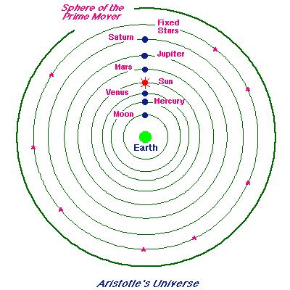

Slide 14
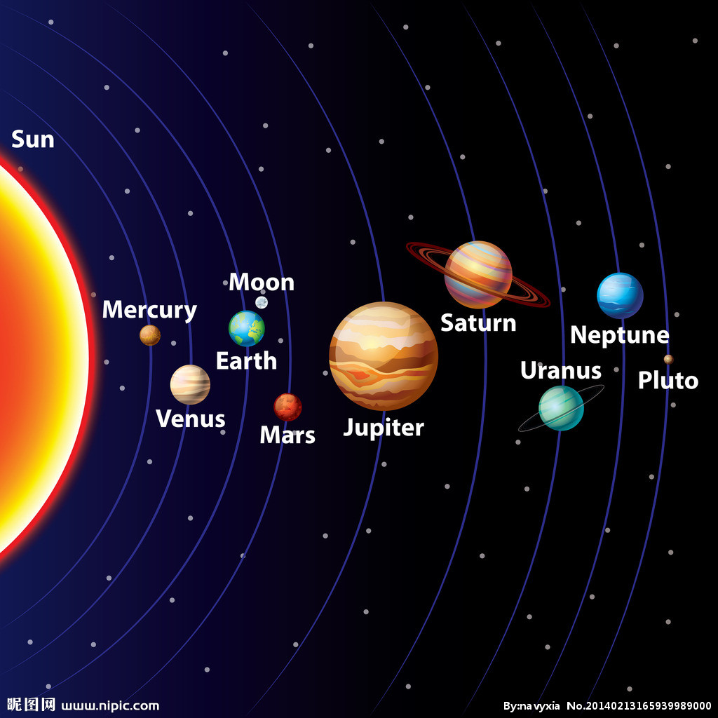

Slide 15
universe cosmos
galaxy system
the Milky way
solar system
interplanetary
debris
comet
asteroid
revolve， orbit( ellipse，elliptical，circle，circular)
rotate, stationary, still
geochemistry
terrestrial planets （earth-like）
territory， territorial
extraterrestrial
Jovian planets
gas giant

Slide 16
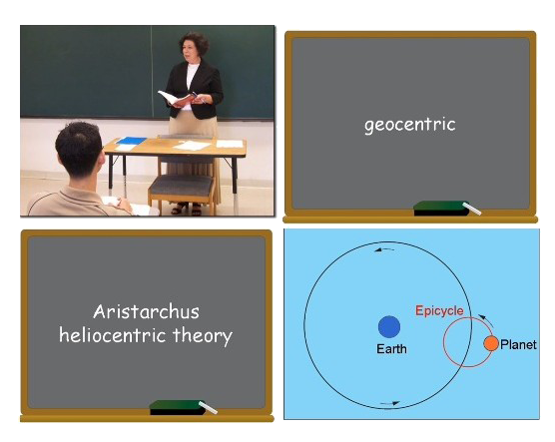

Slide 17
听力预测
开头
主旨句
结构
内容
表达

Slide 18
结构
并列 | 主旨 | 论点1 | 论点2 | 论点3 | 评价总结
比较 | 主旨 | AB比较 | AB比较 | AB比较 | 评价总结
时间 | 主旨 | 时间点1 | 时间点2 | 时间点3 | 评价总结
过程 | 主旨 | 步骤1 | 步骤2 | 步骤3 | 评价总结
问答 | 主旨 | 回答1 | 问答2 | 问答3 | 评价总结

Slide 19
TOPIC Sentence：T21L1
What is HELIOCENTRIC ?
Why did people at the time believe it?
Does it have some problems and why did people insist it?
Is there any opposition against it?

Slide 20
思维导图
笔记的作用
1、防止遗忘
2、整理思路
逻辑词分段

Slide 21
We have been talking about how throughout history it was often difficult for people to give up ideas which have long been taken for granted as scientific truth even if those ideas were false

Slide 22
词汇变形
science, scientific
station, stationary
philosophy, philosophical
religion, religious
astronomy, astronomical
intuition, intuitive
sense, sensible
electromagnetic，
consistent, inconsistent
relevant, irrelevant
visible， invisible
illuminate，luminosity,
compare， comparatively
electronics, electrical
mass, massive
geology, geological
star, stellar

Slide 23
T22L2
What is the main propose of the lecture?
A. To compare solutions to the greenhouse-gas problem
B. To examine methods used to study star formation in other solar systems
C. To discuss evidence for liquid water on young Earth and Mars
D. To discuss attempts to solve a puzzle related to the Sun

Slide 24
Why is geological evidence of liquid water on Earth and Mars three to four billion years ago problematic?
A. It suggests that the solar system is younger than it could possibly be.
B. It suggests that the young Sun was less bright than it is today.
C. It challenges the prevailing model of star formation.
D. It contradicts theories about the beginning of the universe

Slide 25
Why did the greenhouse-gas solution fail to explain the early presence of liquid water on Earth and Mars?
Click on 2 answers
A. The types of gases that were present in their atmospheres could not have caused temperatures to rise
B. There was insufficient carbon dioxide in their atmospheres to produce a greenhouse effect.
C. Solar radiation would have destroyed the ammonia in their atmospheres.
D. Clouds of ammonia would have lowered temperatures by blocking out sunlight.

Slide 26
Why does the professor mention the solar wind?
A. To explain a way the Sun is losing mass
B. To point out that it was less intense billions of years ago
C. To suggest a reason for early climate differences between Earth and Mars
D. To explain the importance of solving the faint-young-Sun paradox

Slide 27
What factor did astronomers consider when calculating the required solar mass for liquid water to exist on Earth and Mars?
A. The young Sun lost mass at a slower rate than it currently does
B. The young Sun was closer to the planets than it currently is
C. The young Sun had less solar wind activity than it currently does
D. The young Sun comprised greater amounts of helium than it currently does

Slide 28
What is the professor's attitude about the bright-young-Sun solution?
A. He is surprised that it is not more widely accepted
B. He feels that it raises too many unanswerable questions
C. He is confident that future research will determine whether it is true.
D. He expects that other possible solutions to the paradox will be proposed.

Slide 29
？T19L2
Radio wave
Light wave
Electromagnetic wave
Optical astronomy
Radio astronomy

Slide 30
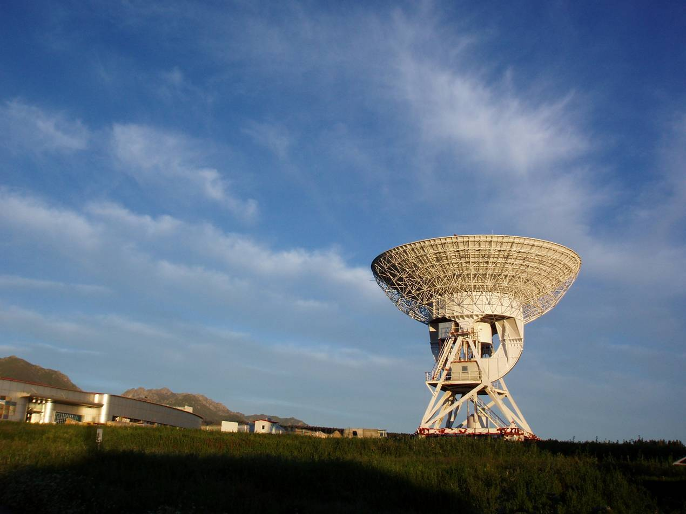
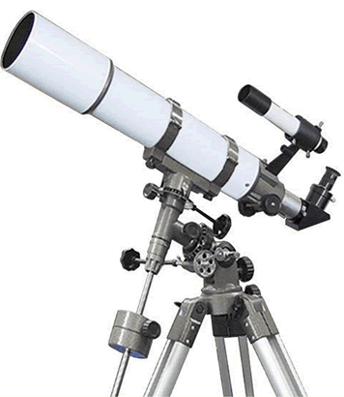

Slide 31
Radio astronomy
Optical astronomy

Slide 32
T19L2比较结构
What is the lecture mainly about?
A. Recent advances in technology used by astronomers
B. How radio astronomy has led to advances in communication technology
C. Important discoveries made by radio astronomers
D. Difficulties astronomers have in observing the universe

Slide 33
What is the professor's attitude about light pollution in cities?
A. He feels that it should be carefully regulated.
B. He believes it is unfortunate
C. He thinks astronomers have not dare enough to address the issue
D. He believes that the severity of the problem is often exaggerated.

Slide 34
According to the professor, why are radio wares particularly useful for astronomical observations?
Click on 2 answers
A. Some astronomical bodies emit radio waves but not visible light
B. Radio waves provide more information about star composition than visible light waves do
C. Radio waves can be detected with simple equipment.
D. Radio waves can pass through particles in space

Slide 35
What does the professor imply is an advantage of optical astronomy over radio astronomy?
A. It allows far more precise observations.
B. It is better for making observations within our own galaxy.
C. It requires less sophisticated equipment.
D. It is not affected by the weather.

Slide 36
According to the professor, why do radio astronomers sometimes have difficulty studying very distant objects?
Click on 2 answers
A. Signals from closer objects interfere with radio waves from space.
B. Particles in the atmosphere change the direction of radio waves.
C. Radio waves from space are not very strong.
D. Light waves from sources on Earth alter radio waves from distant objects

Slide 37
What does the professor mean when he says this:
A. He wants to emphasize the progress that has been made in radio astronomy.
B. He thinks radio astronomy and optical astronomy both provide valuable information.
C. He does not want to spend time discussing the technology of radio telescopes.
D. He would like the students to give examples of discoveries made with radio telescopes.

Slide 38
What is the main purpose of the lecture?
A. To explain the difficulity of classifying distant objects in the universe
B. To introduce a classification system for galaxy clusters
C. To present some recent discoveries about the shapes of galaxies
D. To describe some differences between galaxies and clusters

Slide 39
1、平易近人
2、领先他人
3、说不清楚
4、定制
5、模糊界限

Slide 40
1、She finds the Pope more human and easier to relate to.
她认为教皇更有人情味、更容易接近。
2、The United States of America continues to outperform much of the world.
美利坚合众国继续引领世界发展龙头。
3、Well yes and no. You've listed several different topics on your contents page, but I am not sure they're all relevant.
说不好。你在目录页列举了一些不同的话题，但是我不确定它们都能切题。
4、People want to tailor it because there's a big market in this.
因为这方面市场很大，所以人们想定制。
5、That's true. But times have changed, and comic books these days often blur the line between right and wrong – making things unclear.
没错。但随着时间的推移，在现在的漫画书里，是非界限经常是模糊的，也就是孰是孰非并不明朗。

Slide 41
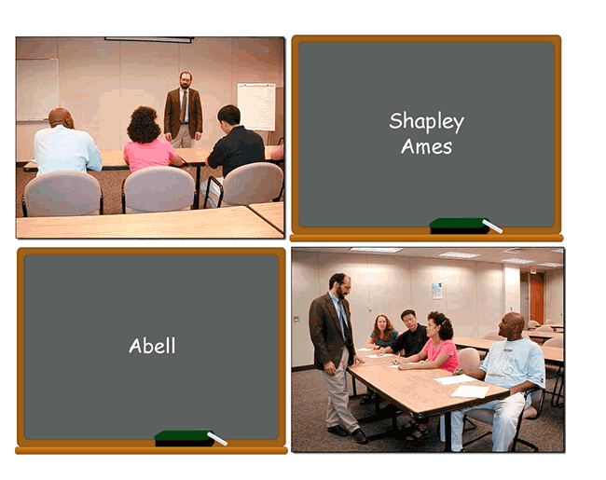
T42L2

Slide 42
作业
1、预习词汇表
2、完成词汇录音
3、完成T42L2, T 13L4
4、选做T5L2

Slide 43
THANKS
ZCY
ZHI YI STUDIO
LISTENING

